Slide 1
Cross-Layer Dataset Design and Exploratory Analysis of an ESP32-Based ESP-WIFI-MESH Network
Thesis 3 defense · NIS16
Calpoporo, Jose Angelo C. · Carlos, Miguel Sebastian C. · Ong, Kyle Edward M. · Reinante, Christian Victor G.
Adviser: Mr. Gregory G. Cu · College of Computer Studies, De La Salle University
October 24, 2026
Notes:
Open with the title and team. Say up front: chapters 1 to 3 are a short refresher, because the panel last saw them months ago; most of the time goes to chapter 4 (how the dataset is built and validated) and the results so far.

Slide 2
Nine months in four steps
1
2
3
4
Thesis 1
Thesis 2
Build
Thesis 3
Proposal: the gap, the objectives, the planned testbed and features
Approved design paper (March 15, 2026); panel comments listed for Thesis 3
Firmware for both attacks, microSD logging, 20 MHz radio, verifier and analysis pipeline
Data campaign at three DLSU sites (Sept. 30 – now) and this final paper
What changed since Thesis 2: 8 boards per run (root + 7 children), three campus sites, three traffic scenarios, an SD-card copy of every log, an independent sniffer, and a 3-sigma verifier that checks every run before it enters the dataset.
Notes:
Timeline of the 9 months. Thesis 2 approved the design; Thesis 3 is the build and the data campaign. Highlight what changed since the panel last saw the work.

Slide 3
Recap of Chapters 1 to 3
1-3
Problem, objectives, literature and the theory the dataset rests on — in four slides

Slide 4
The problem: no real ESP32 mesh attack data
ESP32 mesh networks are cheap and used in IoT monitoring, but attack research on them is done in simulation.
1
Simulated data
2
Missing layers
3
Real attacks
Most IDS datasets come from simulators or IP networks (KDD, NSL-KDD, UNR-IDD), not from mesh hardware.
Packet or flow datasets do not hold the PHY, MAC and network signals of a microcontroller mesh together.
Blackhole and wormhole attacks are well studied in theory; how they look on real ESP32 boards is not documented.
Gap this study fills: a hardware-derived, labelled, cross-layer dataset from a real ESP-WIFI-MESH network under normal operation and two controlled attacks.
Notes:
Chapter 1 in one slide: simulation-based datasets do not show how routing attacks look on ESP32 hardware across layers. That is the gap.

Slide 5
Objectives and scope
General objective
Scope
Design, generate and analyse a cross-layer dataset from an ESP32 mesh to explore how normal operation differs from controlled attacks.
Two attacks: blackhole (forwarding suppression) and wormhole (out-of-band tunnel), emulated at the application layer
8 ESP32 boards per run: one root and seven children
Three indoor DLSU sites on an isolated mesh
A dataset and its exploratory analysis — not an intrusion detection system
Specific objectives
1
Build an ESP32 mesh testbed with normal and attack traffic
2
Collect PHY, MAC and network features into a labelled dataset
3
Check the dataset with EDA and unsupervised clustering
Notes:
Objectives unchanged from the approved paper. Stress the scope line: we build and analyse a dataset; we do not deploy an IDS.

Slide 6
What the literature told us (Chapter 2)
1
Attacks
2
Datasets
Blackhole and wormhole detection is mature in simulation (e.g. Bhatti: 98–99% in ns-2), weaker on real systems.
Existing datasets lack ESP-WIFI-MESH behaviour, cross-layer metrics, real-hardware attacks and several topologies.
3
Platform
4
Method
ESP32 mesh is proven in the field: Khan et al. report delivery above 97% on a campus deployment.
Labelled attack data is scarce in IoT, which motivates EDA and unsupervised clustering.
Notes:
Four takeaways from the review of related literature. The dataset gap (bottom-left) is the one the study answers directly.

Slide 7
The idea behind the dataset (Chapter 3)
Normal mesh traffic keeps a set of cross-layer relationships. An attack breaks some of them, and the features measure the break.
Relationship
Under normal operation
When it breaks
Received ≈ forwarded
Every relay passes on what it gets
Blackhole: received ≫ forwarded
One copy per probe
Each probe reaches the root once, by one path
Wormhole: a second copy through the tunnel
Delay follows hops
Deeper nodes take longer to reach the root
Wormhole: a shortcut breaks the pattern
Parent layer < child layer
The tree stays consistent
Watched: not expected to change here
Notes:
Chapter 3 framework: normal behaviour is a set of consistent relationships; an attack breaks specific ones. That is why the features are ratios and mismatches, not raw values.

Slide 8
Chapter 4: Research Design
4
How the testbed runs, how both attacks are built, how data is collected, turned into features and checked

Slide 9
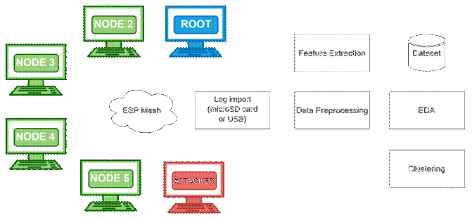
From boards to dataset
1
Each board logs at 10 Hz to flash and a microSD card
2
Logs are imported after the run (card reader or USB)
3
Preprocessing: one-second windows, labels kept
4
Features: forwarding, delivery, topology, RSSI, tunnel
Figure 4.1 Architecture Design
Independent check: a laptop sniffer outside the mesh records the 802.11 frames, so attack evidence never rests only on the attacker counting its own drops.
5
EDA and clustering on the windowed table
Notes:
Walk the pipeline left to right. The data collector is a file import after the run, not live collection over the mesh — so an attack cannot destroy its own evidence.

Slide 10
Every run follows the same timeline
Formation
≥ 60 s
Baseline
300 s
Attack
180 s
Cooldown
120 s
→ Terminate
label 255, excluded
label 0
label 1 blackhole / 2 wormhole
label 0
R
Root controls it
G
Gates before START
L
Labels by schedule
Phase sent to every node in 5 rounds, 100 ms apart, one sequence number
Repeated every 10 s for nodes that rejoin
Every child present, tree attacker has a child, wormhole ends report UART OK with A shallower (D-22)
Operator types START
Each row carries the phase it was logged in
Labels never come from a feature threshold
Notes:
Ground truth comes from the schedule, not from the data. Formation rows are excluded. Since Oct. 17 the root holds the baseline until the gates pass and someone types START.

Slide 11
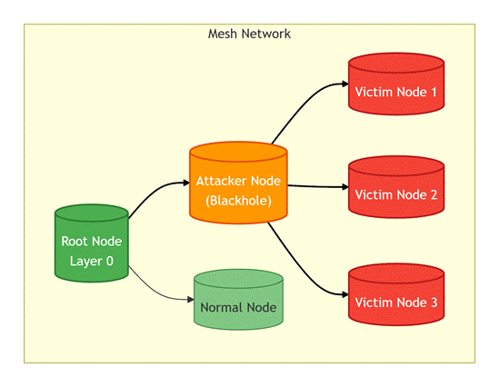
Blackhole: forwarding suppression
Every node relays its children's probes one hop up and counts received, forwarded and dropped
The attacker runs the same relay; in the attack phase it simply does not call esp_mesh_send()
It still acknowledges every frame at the link layer, so victims see no send failure
Received = forwarded + dropped on every node, so forwarding features exist on all relays
Figure 4.4 Attacker as intentional relay
Not reproduced: luring traffic with a false route. ESP-WIFI-MESH lets an app read its routing table but not write it, so the attacker is a placed relay (D-20).
Notes:
Blackhole is an application-layer emulation. Be ready for the question "why not route attraction?": there is no API to write the routing table, so the attacker position is an experimental variable instead.

Slide 12
Wormhole: an out-of-band tunnel
normal path: hop by hop
What it shows
The packet-level signature of a wormhole: duplicate arrivals and a delay mismatch.
Root
A
B
UART wire, 115200 baud, 30-byte frames with CRC32
What it does not
The mesh never routes over the wire, so no false neighbour appears and the tree does not change (D-20).
Node B (deeper) sends each probe normally and, in the attack phase, also writes it to the wire
Node A (shallower) re-injects it toward the root, tagged so the root keeps it
The root receives every B probe twice, by two paths, with different delays
Ends are chosen at run time by mesh depth and locked at phase 0 (D-17)
Notes:
A wire plays the role of the GSM/GPRS tunnel in Zhukabayeva et al. Only Node B's own probes are tunnelled, so a wormhole run has no victims; every other node is "not tunnelled". Be honest that the false-neighbour effect is not reproduced.

Slide 13
Checked against published definitions
Blackhole vs Airehrour et al. [70]
Wormhole vs Hu, Perrig & Johnson [46]
✓
On the forwarding path
✓
Two colluding endpoints
✓
Receives, then drops
✓
Out-of-band channel
✓
Stays protocol-compliant
✓
Captured at one end, replayed at the other
✓
Delivery collapses, node reachable
✓
No keys or hosts compromised
✗
Attracts traffic with a false route
✗
Creates a false neighbour
Evidence: G402 linear stationary — attacker forwarded 1 of 1,077 probes and all six victims fell from PDR 1.000 to 0.000. All nine linear wormhole runs — the root saw duplicate arrivals in 179–193 attack windows each, none in baseline or cooldown.
Notes:
Tables 4.4 and 4.5. We list the criteria that fail as well — the route-attraction and false-neighbour parts — because they follow from the application-layer emulation.

Slide 14
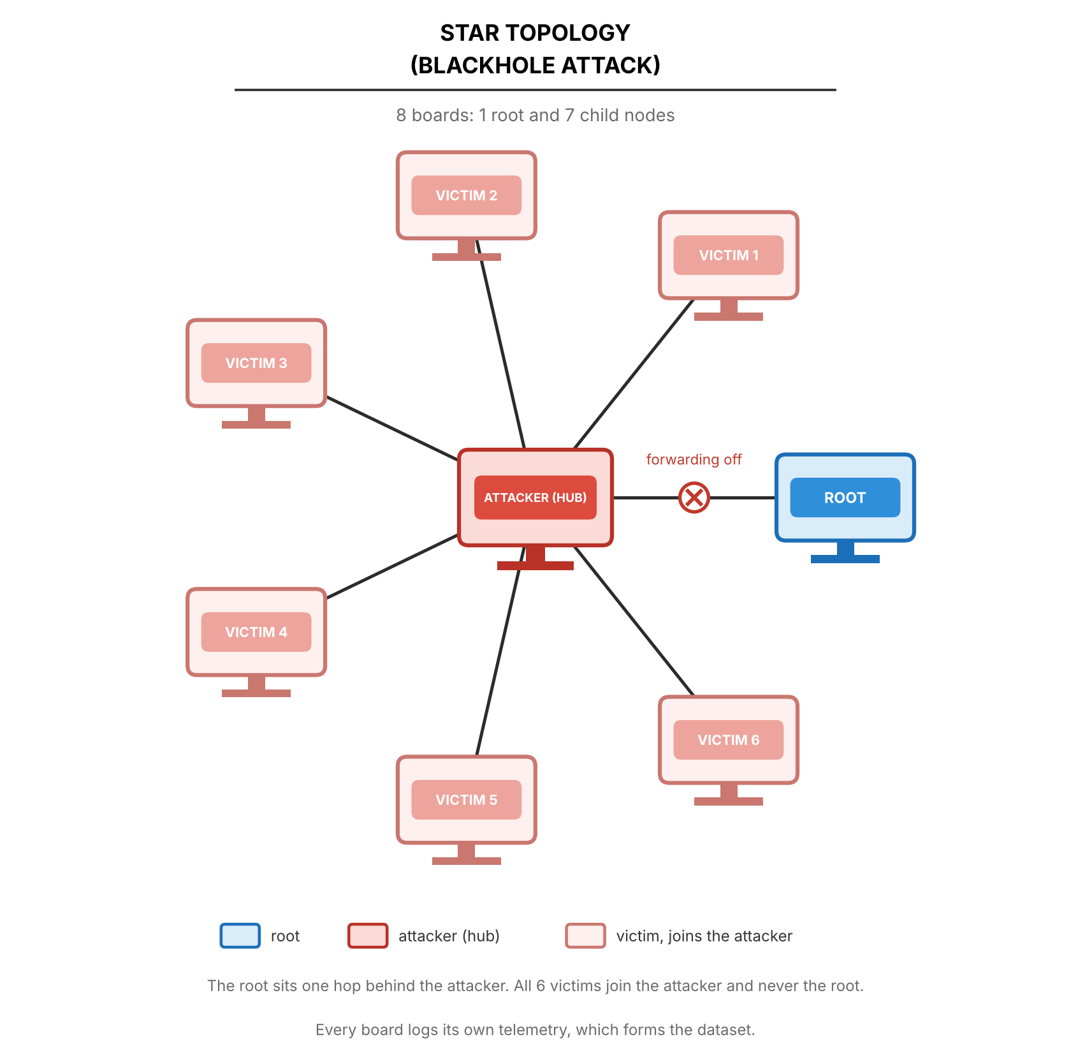
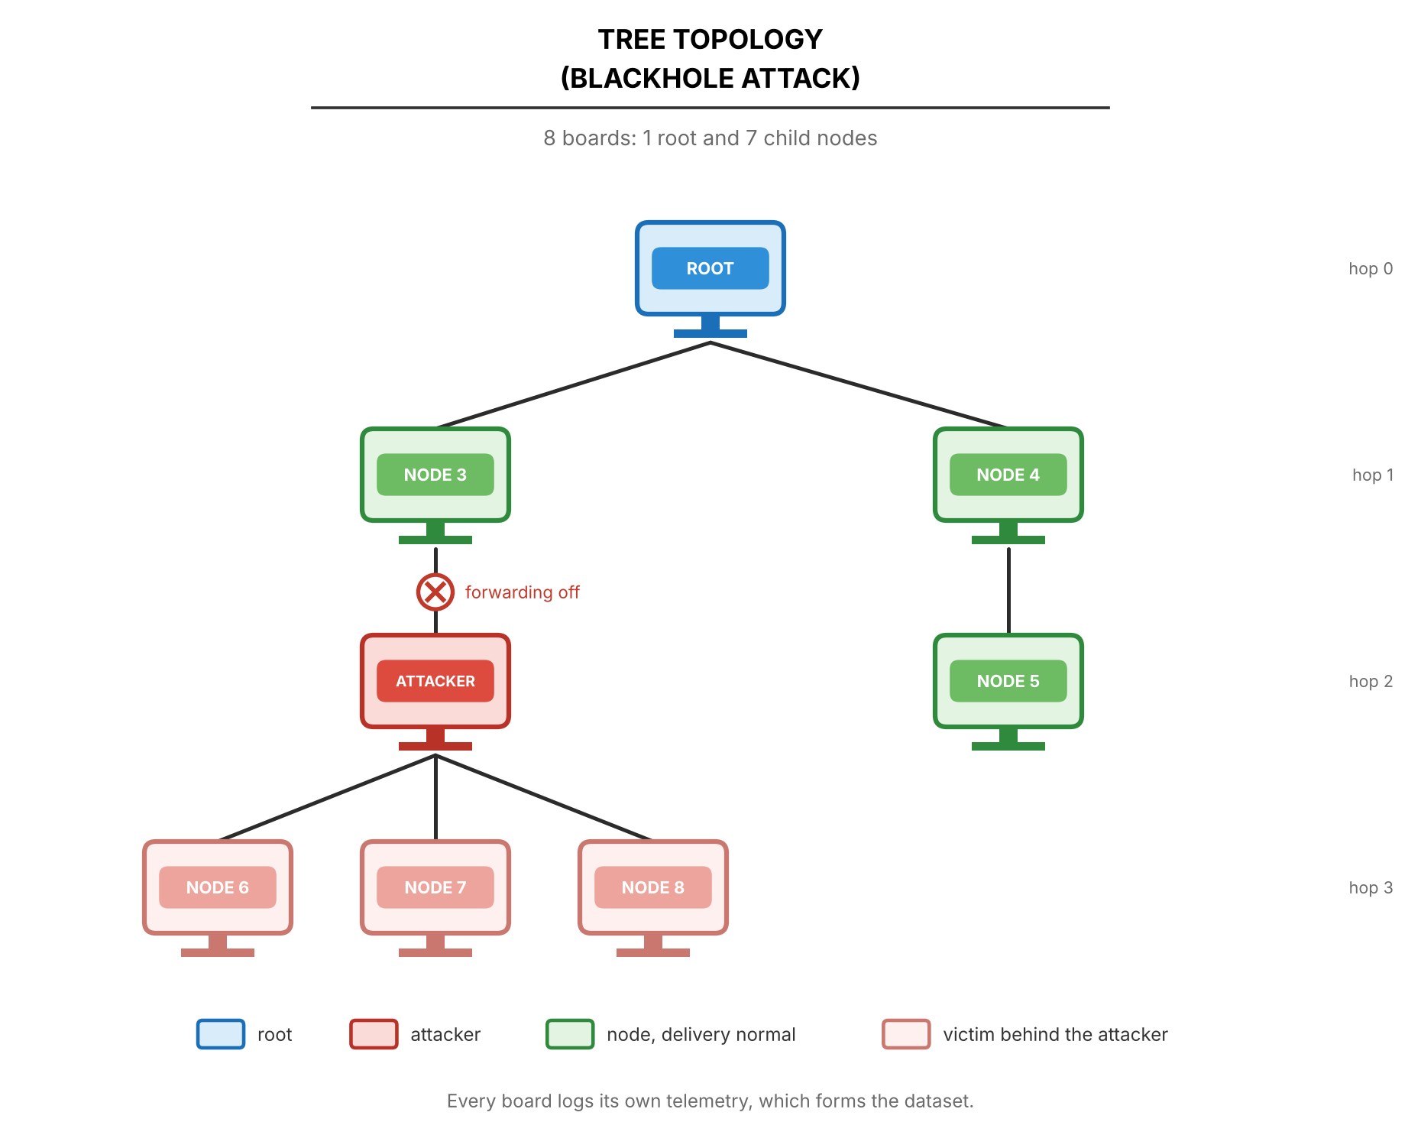
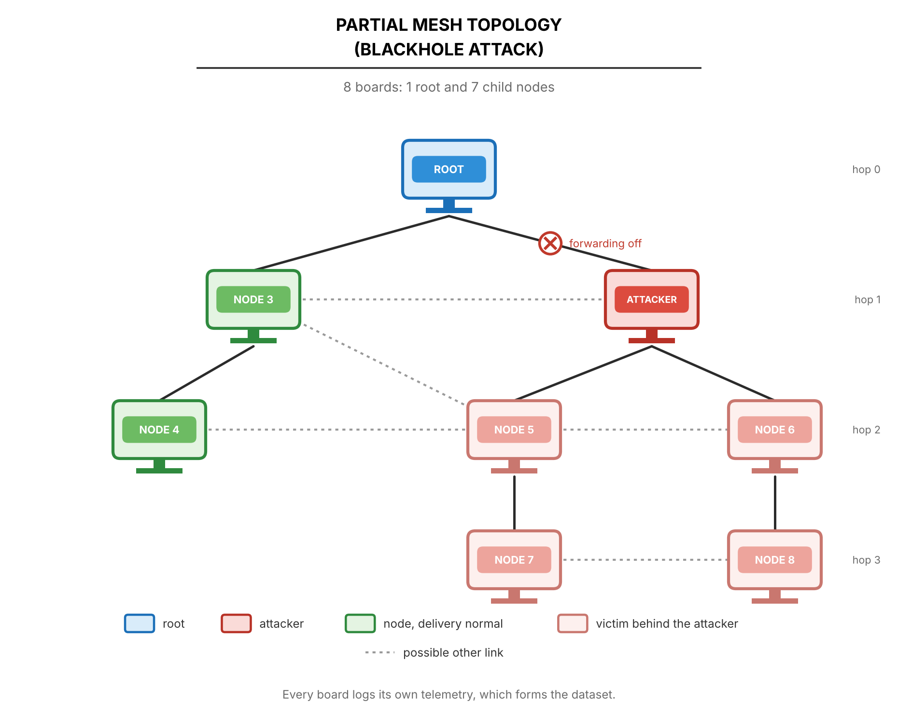
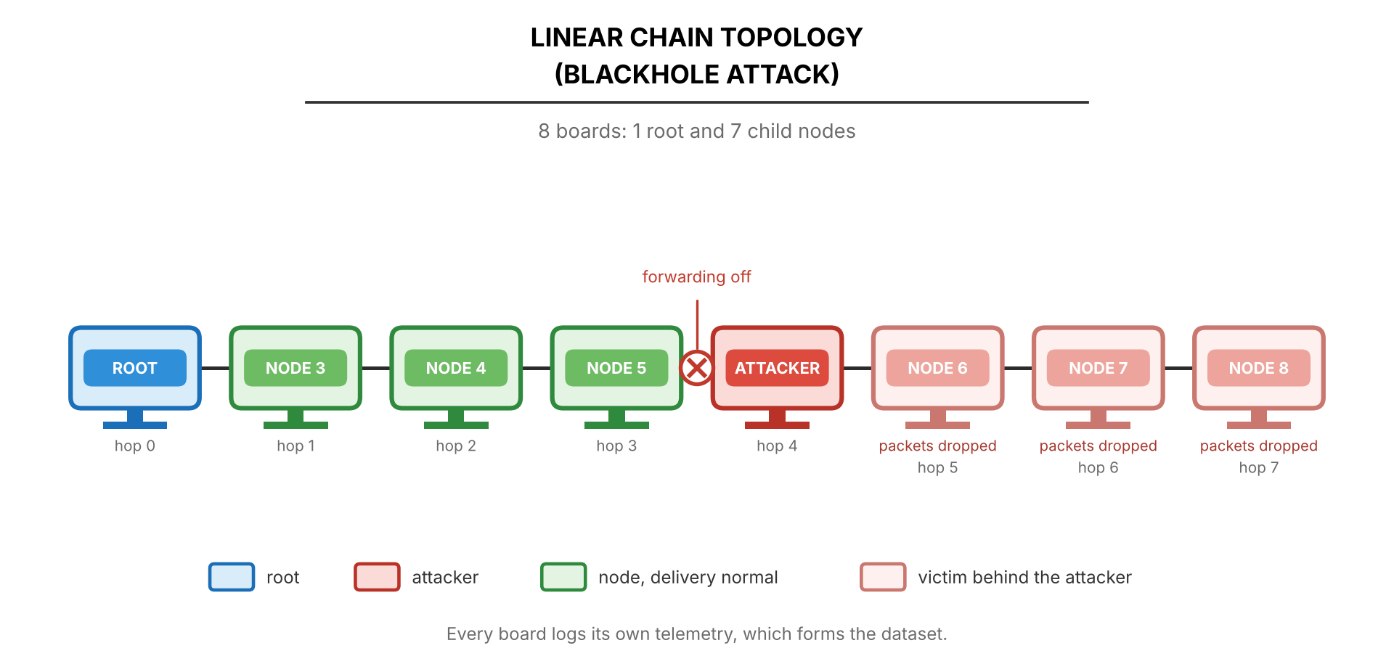
Four topologies under the blackhole
Star
Tree
Linear chain
Partial mesh
Layouts come from board placement plus the ESP-IDF topology option; the mesh still builds its own tree
Star: the attacker is the hub and the root sits one hop behind it (D-16)
The attacker's depth and number of victims vary by run; the drawings show one example layout
Notes:
Figures 4.17, 4.19, 4.21, 4.23. Mention that the partial mesh behaved as a plain tree in all nine runs — no node was seen under a second parent during the attack.

Slide 15
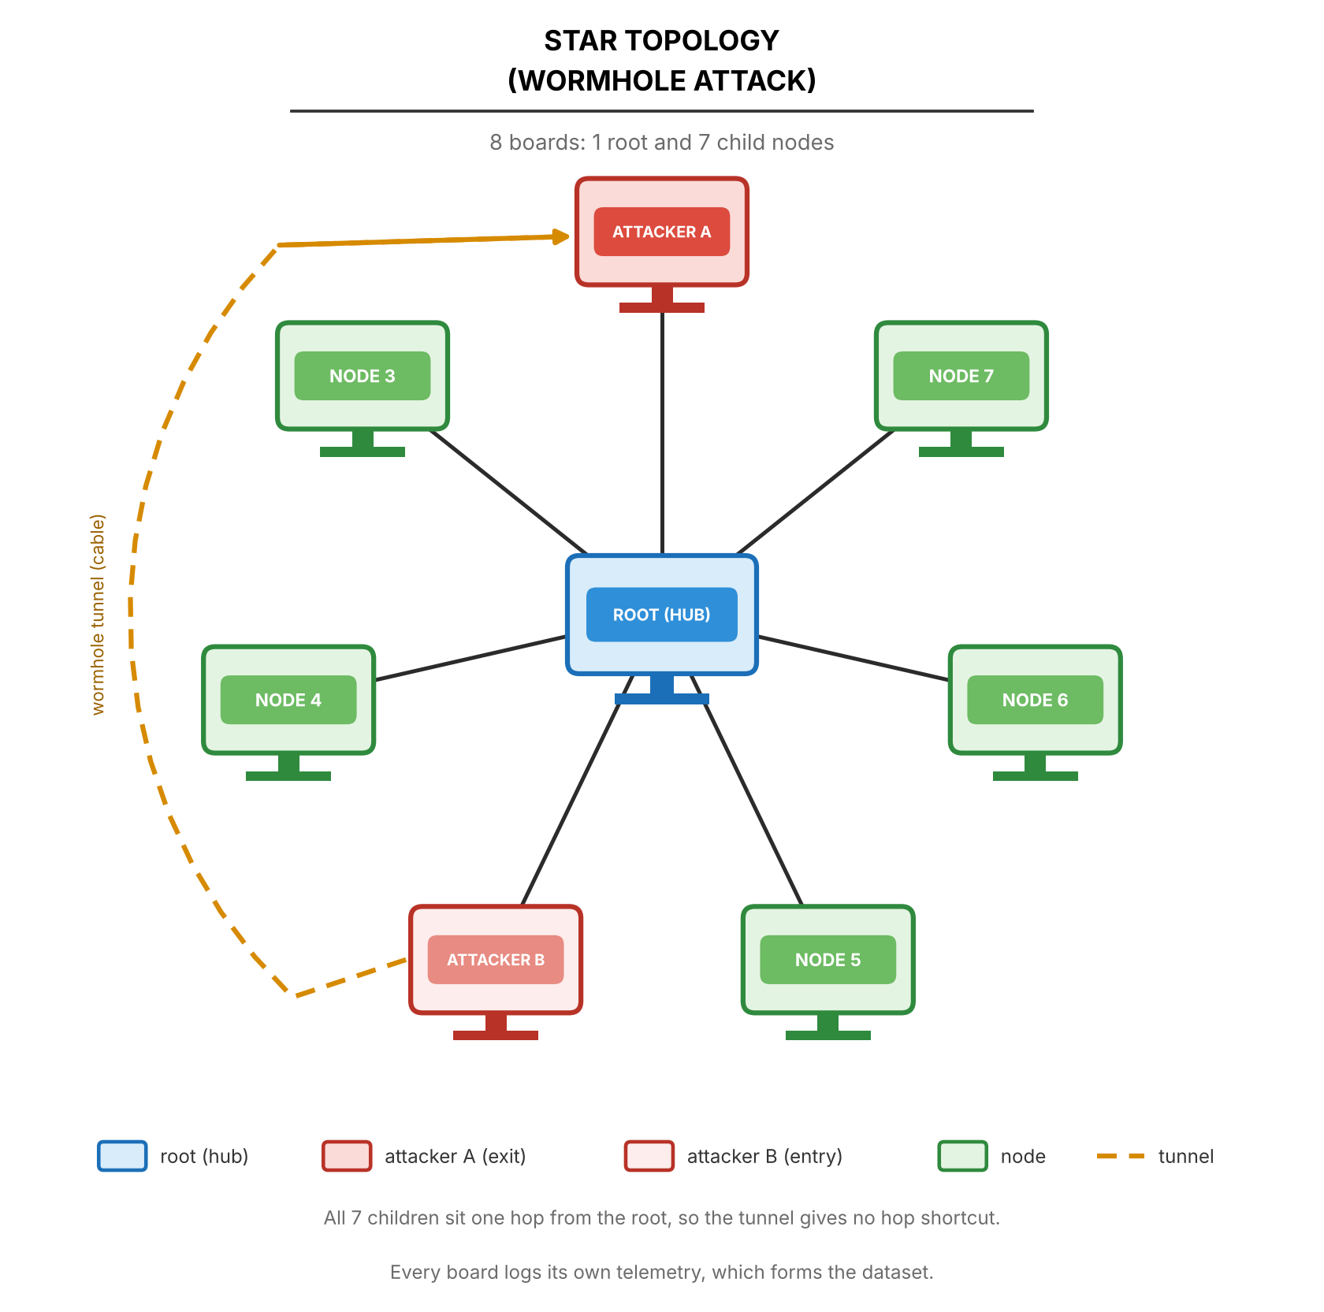
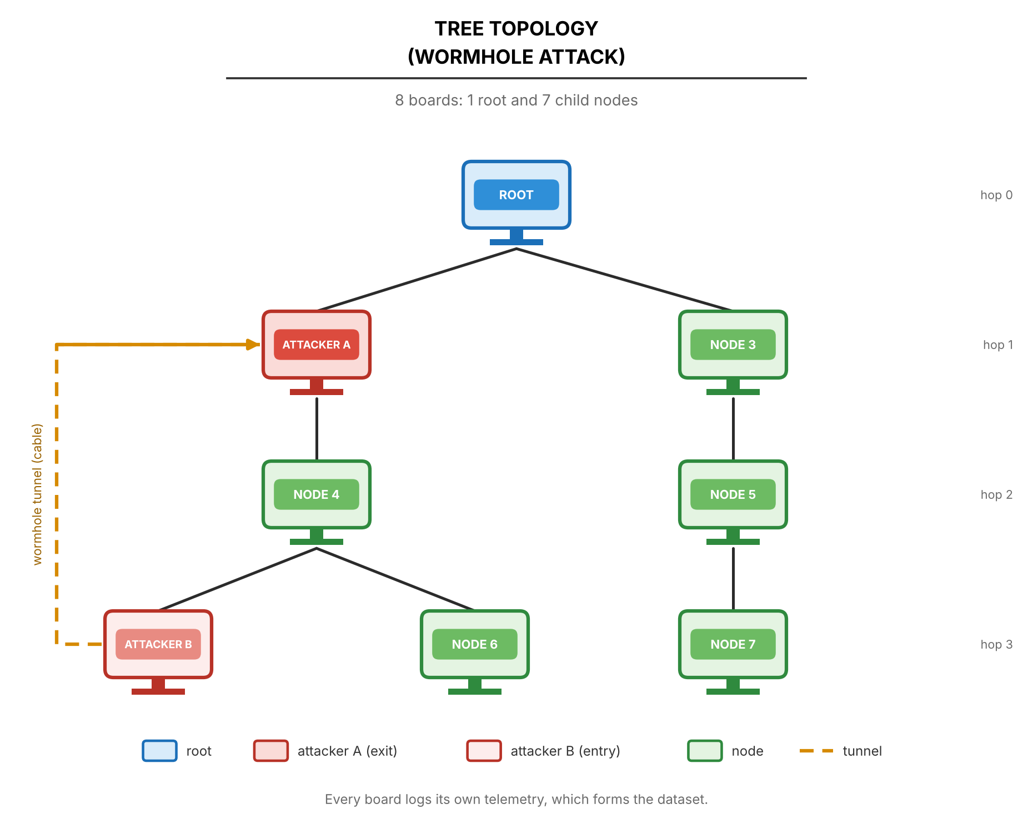
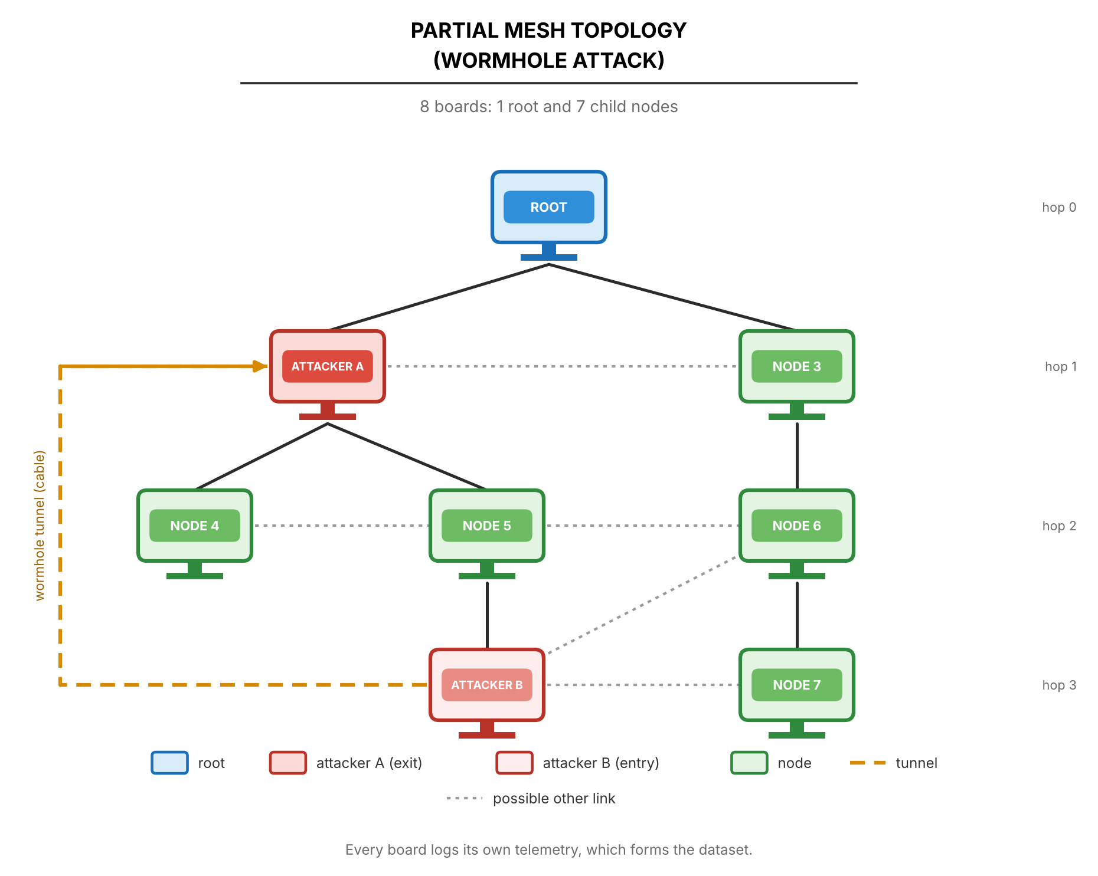
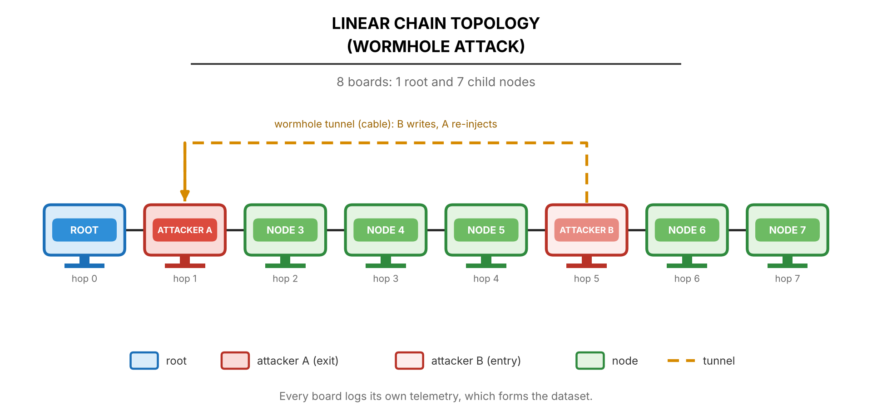
Four topologies under the wormhole
Star
Tree
Linear chain
Partial mesh
The tunnel must skip hops, so Node A must sit shallower than Node B
In a flat star both ends are at hop 1 and nothing is skipped: the team proposes making end A the hub with the root behind it (D-28, adviser to confirm)
All nine processed wormhole runs are on the linear chain so far
Notes:
Figures 4.16, 4.18, 4.20, 4.22. The star wormhole is the open design question: D-28 hub-star. First hub-star attempts on Oct. 20 failed because the hub board browned out — hardware, not design.

Slide 16
Sites, scenarios and the run design
Three sites — different Wi-Fi interference
Three traffic scenarios
1
G402 (GCCS) Controlled classroom
Stationary Probe every 1 s — the reference
2
DLSU Library Small area of a busy library, heavy Wi-Fi
Burst 300 probes back to back, 60 s into the attack window
3
Yuchengco Building Area within the building
Highload Every child probes every 250 ms
4 topologies × 2 attacks × 3 sites × 3 scenarios = 72 attack runs
+ 9 matched benign runs (one per scenario at every site) = 81 runs. Each cell is run once, so the three sites act as the repeats.
Notes:
The design matrix. Scenarios exist so traffic volume alone cannot reveal an attack. Single run per cell is a limitation we state: site and run-to-run noise cannot be separated.

Slide 17
What each board records
PHY
MAC
Network
Tunnel
RSSI to the parent, 10 Hz
Radio fixed at 20 MHz (HT20) so the sniffer can decode frames
MacRetryRate from the sniffer's 802.11 Retry bit
retry_count / tx_count are app counters, kept but not analysed (D-15)
Layer / hop, parent MAC
Probes sent, received, forwarded, dropped
Root logs every probe arrival
Frames written (B), received and re-injected (A)
Wormhole runs only
Storage: flash plus a microSD mirror (fsync every 5 s). Nothing is streamed over the mesh during a run, so the attack cannot destroy its own evidence. None of the 435 campus capture files is empty.
Notes:
Tables 4.8 to 4.12. Be precise about MAC: ESP-IDF exposes no per-link retry counter, so real MAC retries come only from the sniffer.

Slide 18
From raw rows to one-second windows
1
Align
Boards share no clock, so each node is aligned to its own exit from phase 0
One row =
one node × one second
Node-level rows keep the local effect visible: the attacker's forwarding falls while the nodes behind it lose delivery. A network average would hide both.
2
Window
Non-overlapping 1 s windows on a 10 Hz grid; fewer than 8 of 10 samples = discarded
3
Fill
Gaps of 1–2 samples inside a kept window are filled (D-9)
4
Count
Cumulative counters become per-window deltas
5
Join
PDR joins root arrivals to each node on the sequence number, never on time
Notes:
Section 4.2.4.1. The sequence-number join matters: clocks drift by minutes between boards.

Slide 19
Features, grouped by what they measure
Forwarding
Delivery
Topology
ForwardingRatio, IngressEgressDelta, ConsistencyScore
PDR per child per window (blank when nothing was sent)
ParentSwitchRate, HopChangeCount, HopStabilityDuration
Physical
Cross-layer
Tunnel
RSSI mean, variance, stability
RSSI_Hop_Diff, LatencyHopRatio
TunnelIntensity, TunnelBytes, TunnelLatency, DuplicateRate
Notes:
Table 4.17. Each group maps to a Chapter 3 relationship. RetryRate (app counters) is a dataset column only; MacRetryRate comes from the sniffer.

Slide 20
Analysis plan: EDA, then clustering
E
Exploratory data analysis
C
Clustering
Distributions of ForwardingRatio and RSSI_Hop_Diff by phase and role
Time series of PDR, ForwardingRatio and root arrivals over the run
Pearson and Spearman correlations: all, baseline only, attack only
PCA and t-SNE on z-scored features (clipped at ±5)
Descriptive only — no detection claims
DBSCAN (primary), K-Means, Ward hierarchical, GMM, spectral
Full and reduced feature sets; seeds 42, 7 and 123
Internal quality: silhouette, Davies–Bouldin
Labels used only afterwards: purity and adjusted Rand index
If wormhole windows do not separate, that is reported as a finding
Notes:
Labels never guide the clustering; they are used only to interpret clusters afterwards. Clustering runs once collection ends.

Slide 21
How every run is validated
1
3-sigma test
2
Setup check
An attack-phase window is flagged when it lies more than 3 baseline standard deviations from the baseline mean (Zhukabayeva et al.)
Topology during the attack, attacker position, victims alive but cut off; for the wormhole, B deeper than A and the wire carried the probes
3
Published studies
4
Leakage audit
Direction and rough size compared with Airehrour, Khan, Zhukabayeva and Ramírez Gómez — consistency, not proof
Can one feature alone separate attack from normal? If so, it is reported, not hidden
Notes:
Section 4.1.3. A run that fails the setup check is "not confirmed" however clear the statistics look. Outcome per run: PASS, FAIL or INCONCLUSIVE.

Slide 22
Results so far
5
Run status, verified attacks, first EDA and how our numbers compare — provisional until all 81 runs are in

Slide 23
Campaign status, October 20, 2026
44 / 72
attack runs processed: 35 blackhole + 9 wormhole
0 / 9
matched benign runs captured
5 captures held out: tree/G402/highload (one board has no data), wormhole tree/DLSU (4 boards < 95%), and 3 wormhole runs not yet analysed. 37 runs remain.
Notes:
Blackhole is complete except one held-out tree run. Wormhole is done on the linear chain at all sites and scenarios; star, tree and partial still need captures. Benign runs are next.

Slide 24
Every processed run passes the verifier
35 / 35
9 / 9
0
blackhole runs PASS: signature, setup and data complete
wormhole runs PASS on the linear chain
parent switches or hop changes inside any wormhole attack window
Blackhole: attacker forwarding drops to 0% in every run; victims lose delivery while bystanders keep it
Wormhole: the wire delivered 99–101% of Node B's frames; the root saw duplicate arrivals in 179–193 attack windows per run and none outside the attack
Partial mesh: in all nine runs each node stayed under one parent during the attack, so these runs behave as trees
Two runs rated INCONCLUSIVE and held out; nothing in the processed set relies on them
Notes:
Numbers from tools/verify_attack.py run on all campus runs on Oct. 20, 2026 (verification #71).

Slide 25
Blackhole example: G402, linear, stationary
Root → attacker → six victims in a chain
The attacker received 1,077 probes in the attack and forwarded 1
All six victims fell from PDR 1.000 to 0.000, then recovered in cooldown
Baseline never varied (sd = 0), so the move is beyond any sigma
Neighbours confirm it: the attacker's children handed it probes its parent never received
Notes:
Verifier output, verification #71. Cooldown PDR 0.999 is from the cooldown windows of the same feature table.

Slide 26
Wormhole example: the second copy
Site | Scenario | B → A frames | Attack windows with duplicates
DLSU Library | stationary | 180 / 180 | 180
DLSU Library | burst | 179 / 179 | 179
DLSU Library | highload | 720 / 720 | 180
G402 | stationary | 179 / 180 | 179
G402 | burst | 180 / 180 | 193
G402 | highload | 716 / 720 | 179
Yuchengco | stationary | 179 / 179 | 179
Yuchengco | burst | 180 / 180 | 180
Yuchengco | highload | 720 / 716 | 180
Linear chain, all nine runs
DLSU stationary: the root saw both copies in 180 attack windows, about 3.6 ms apart
No duplicates in baseline or cooldown
Both primary signatures (TunnelIntensity, DuplicateRate) move from 0 to 1
TunnelLatency is reported, not tested: it has no baseline to test against
Notes:
Wire delivery from the verifier's UART check. Highload sends 4 probes a second, so ~720 frames.

Slide 27
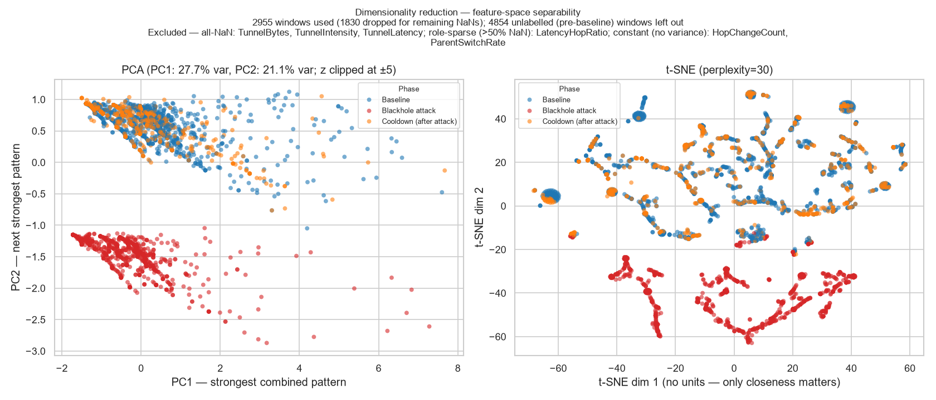
First EDA view: attack windows sit apart
PCA (left) and t-SNE (right) of the G402 linear stationary blackhole run, z-scored features. Red = attack windows, blue = baseline, orange = cooldown.
This describes a picture of one run. It is not a detection result; the pooled clustering will test it.
Notes:
Per-cell EDA output from the analysis pipeline. Stress the wording: a description, not a classifier.

Slide 28
Can one feature decide it? The leakage audit
Majority-class rate ≈ 0.70
PDR and LatencyHopRatio reach ≥ 0.95 in 12 runs each (9 star + 3 linear)
Expected: a blackhole drops everything, so the collapse is separable by construction
RSSI and hop features stay at the majority rate
Pooled audit over all runs follows once collection ends
Notes:
Table 4.21, provisional. This answers the Thesis 2 panel concern that one feature might decide everything: it does in some runs, and we say so.

Slide 29
How our numbers compare with published work
Measure | Published | Our dataset | Reading
Loss under an unmitigated blackhole | 60–75% [70] | 100% (six victims 1.000 → 0.000) | Above the range: every routed probe is lost
Healthy delivery, same ESP32 platform | > 97% [22] | Baseline PDR 1.000 (G402); 0.998 mean over all victims | At or above the benchmark
Routing instability under attack | 16–246 rank changes [70] | Almost no parent switches | Differs: suppression does not change routes
Wormhole effect | Hop count 4 → 3, delay up ~40% [71] | Duplicate arrivals, no hop change | Partly matches: the copy, not the shortcut
Platforms, scales and protocols differ, so the comparison is about direction and rough size, not equal values.
Notes:
Table 4.23, corrected on Oct. 20 (the earlier 76% figure was from an old capture). Our baseline PDR is per one-second window; Khan's comes from a five-day stability test.

Slide 30
Predictions we tested and did not see
1
Victims retransmit more (blackhole)
2
Topology distorts (wormhole)
Not observed: the attacker still acknowledges every frame at the link layer
Sniffer: MacRetryRate rose in 8 of 22 covered runs (Oct. 19 tables) — no consistent rise
App counters did not change in any of the 34 runs of Oct. 15
Not observed: no parent switch or hop change inside any attack window
The mesh never routes over the wire, so the tree stays the same
The tunnel reproduces the duplicate-delivery signature without the topological one
Why keep them: Tables 3.4 and 3.5 were written before any capture. Reporting what did not happen is part of the result. The sniffer count is being recomputed after a re-analysis dropped the sniffer column.
Notes:
Section 4.1.3.4. Be upfront: the sniffer figure is from the Oct. 19 tables and must be recomputed once the PCAPs are merged back (checklist B-mrr).

Slide 31
Limits we state in the paper
!
Emulated attacks
!
One run per cell
!
Fixed schedule
No route attraction (blackhole) and no false neighbour (wormhole) — D-20
Sites act as repeats; site and run noise cannot be separated
The attack starts at the same time in every run, so position is kept out of model inputs
!
Partial mesh = tree
!
Small testbed
!
Open checks
No node used a second parent in nine runs
8 boards indoors; not a large or outdoor network
SD fsync mid-run reset test (D-13); star wormhole design (D-28)
Notes:
Section 1.4.1 and 4.1.3.5. Naming limits first takes the sting out of panel questions.

Slide 32
What is left before the final paper
1
Capture
37 runs: wormhole on star, tree and partial mesh, plus all 9 benign runs
2
Re-analyse
Merge the sniffer captures back, then recompute MacRetryRate results
3
Cluster
Run the five algorithms on the pooled table and report purity and ARI
4
Write
Chapter 5 from the final tables only; pooled leakage audit; clear every placeholder
Notes:
Chapter 5 is written only from the final tables. The jitter scenario is out (team decision, Oct. 20); the remaining open design question for the adviser is the hub-star wormhole (D-28).

Slide 33
A labelled, cross-layer dataset from a real ESP32 mesh
44 verified attack runs so far, two emulated attacks, four topologies, three sites — every run checked before it enters the dataset.
Thank you. Questions?
Notes:
Close on the contribution and open the floor.

